Slide 1
COSC 4351 Spring 2022 Software Engineering M & W 1 to 2:30
Prof. Victoria Hilford

Slide 2
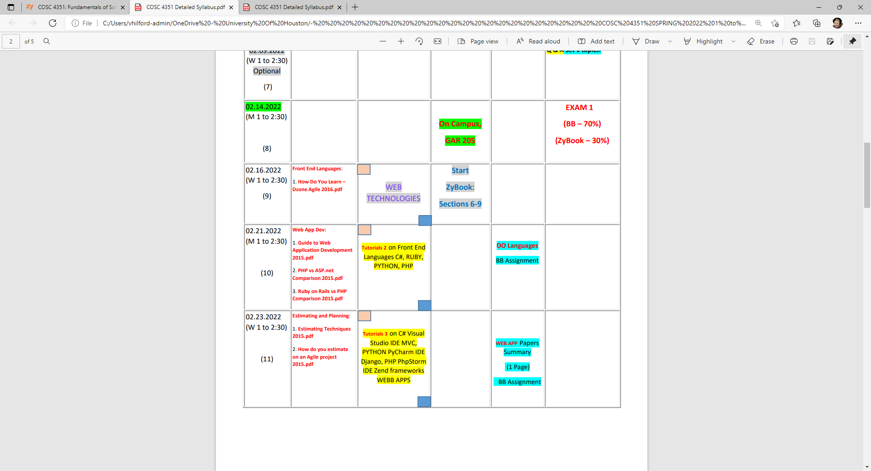
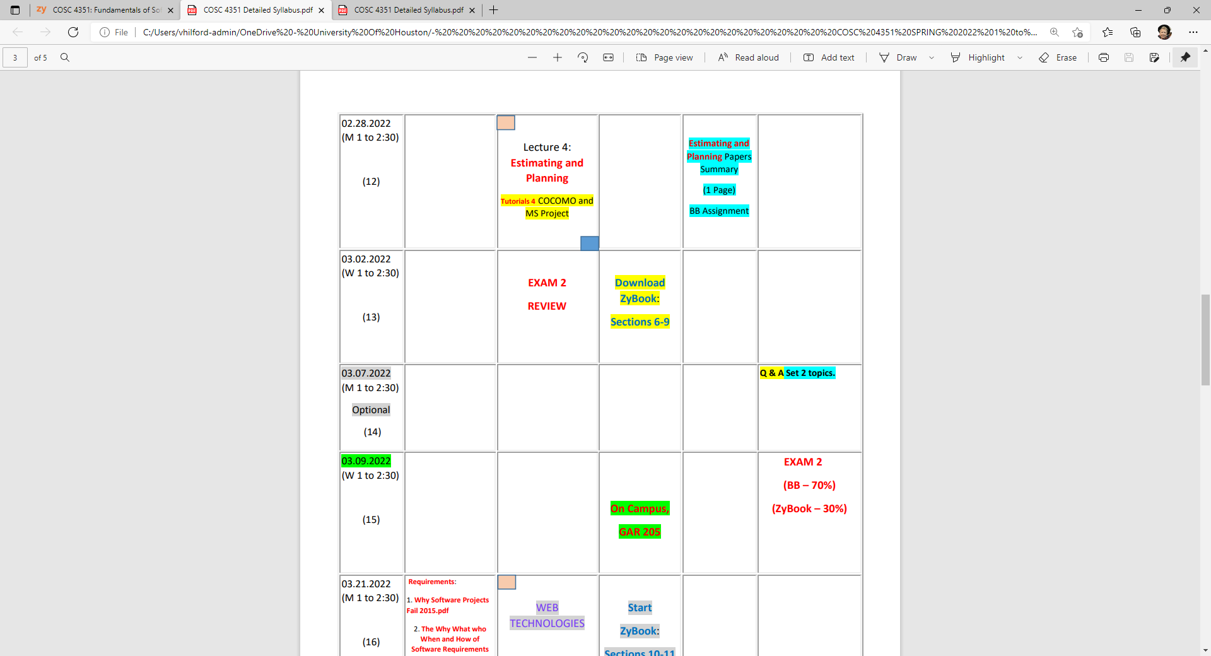

Slide 3

Class 11
Tutorial 3 on
WEB APPs

Slide 4
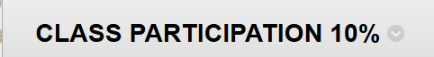
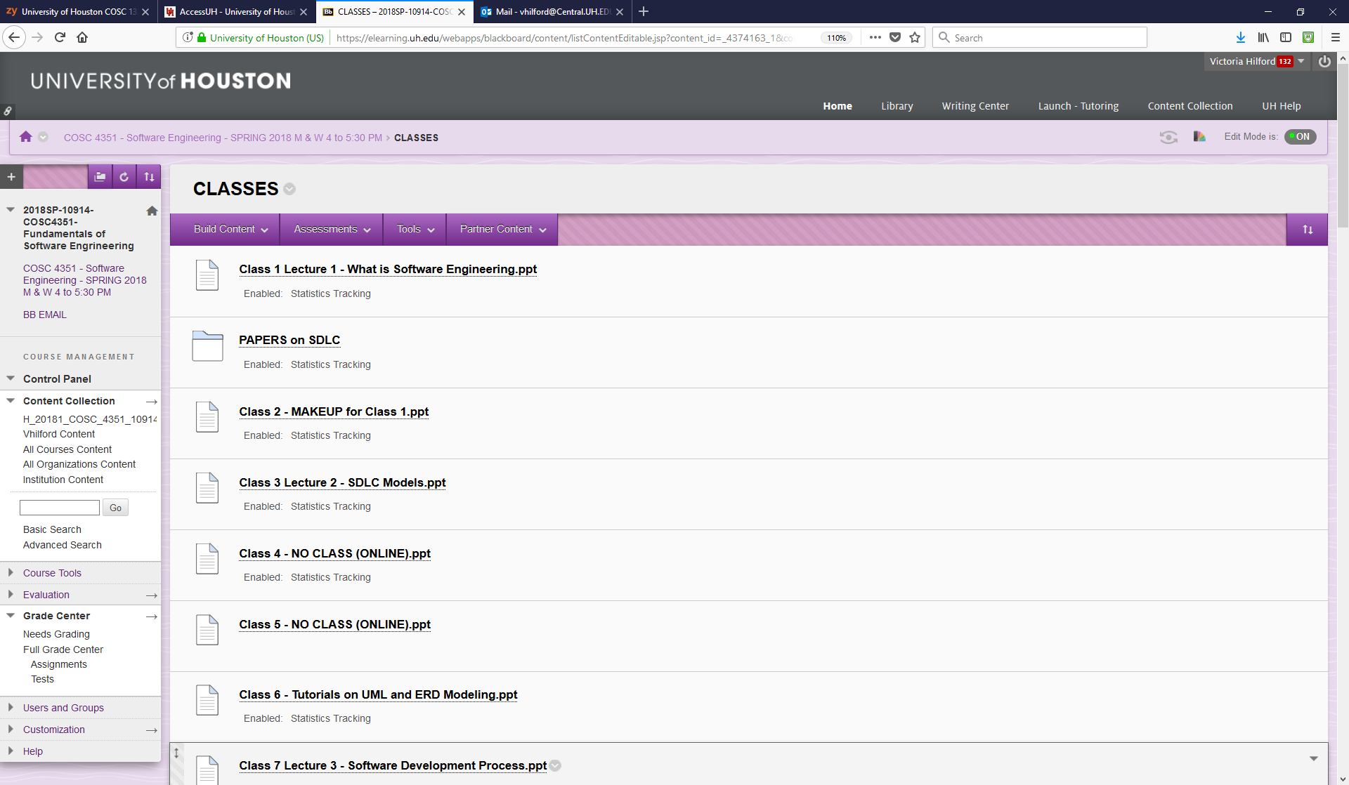
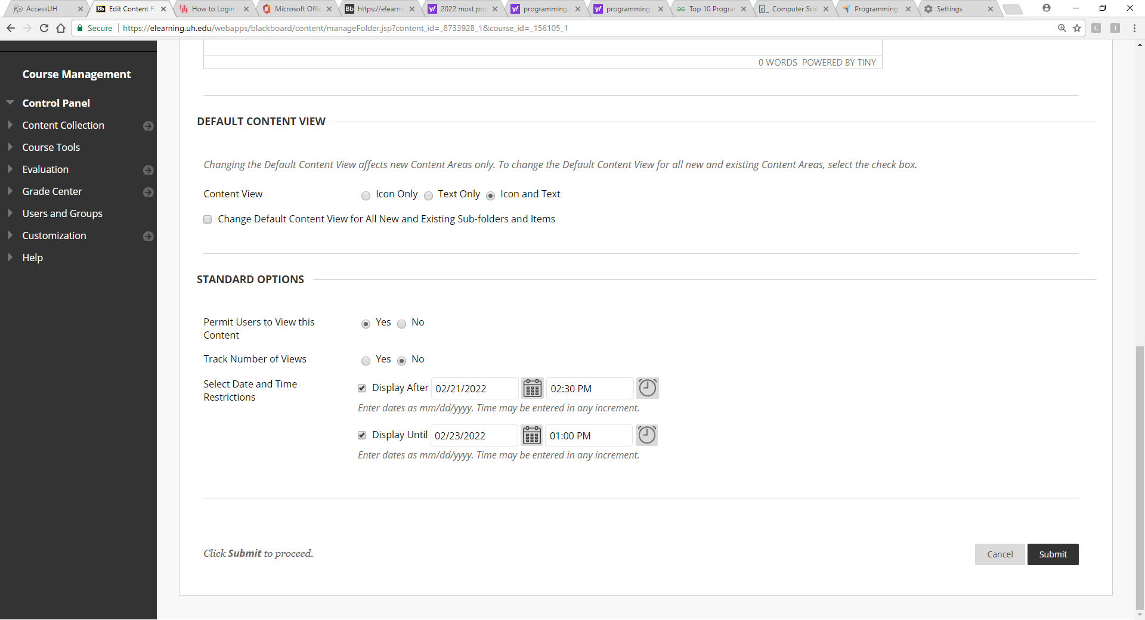
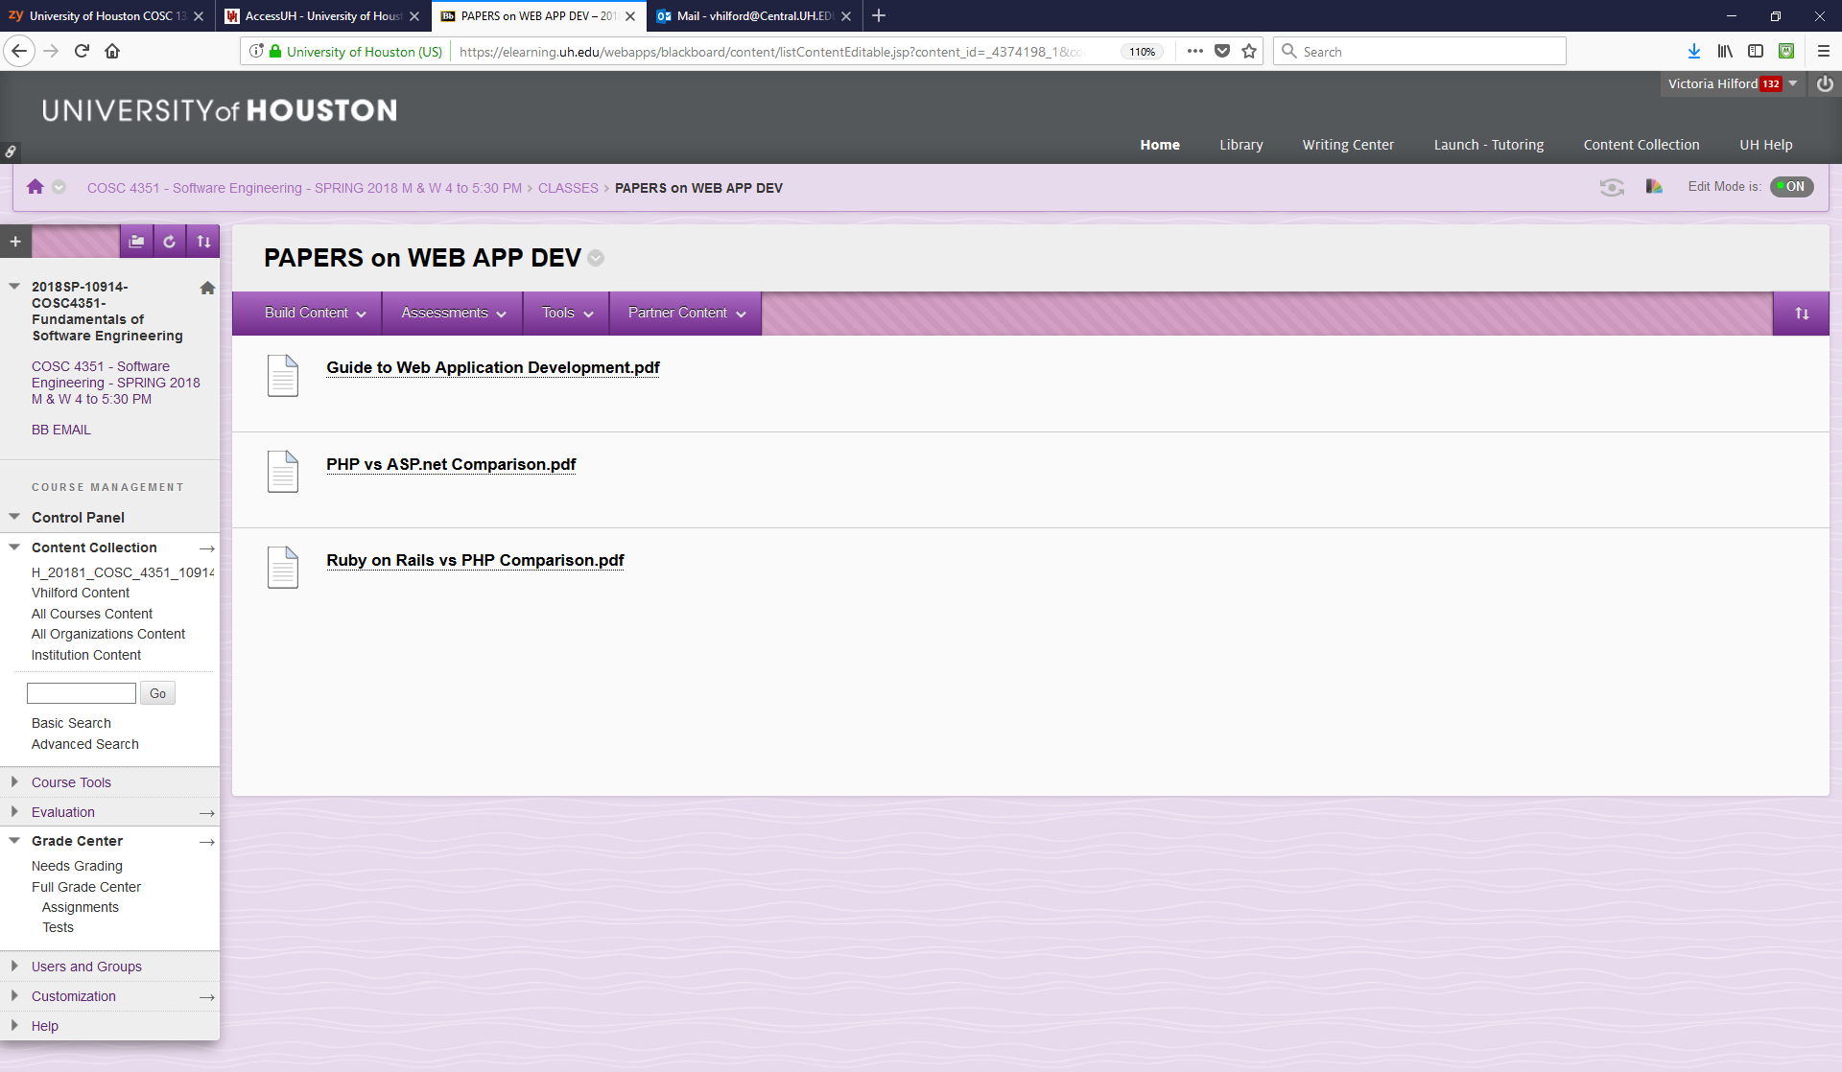
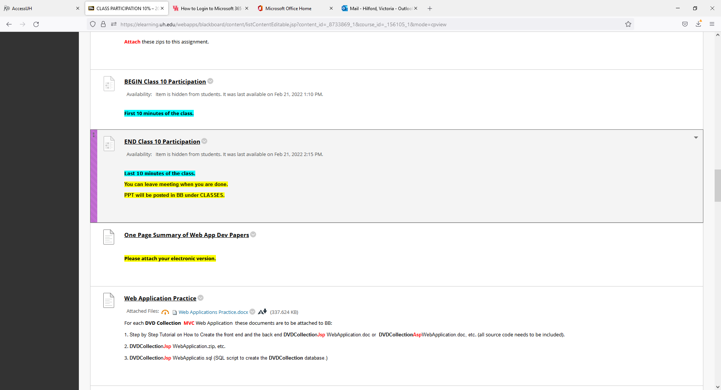
At 1:00 PM.

Slide 5
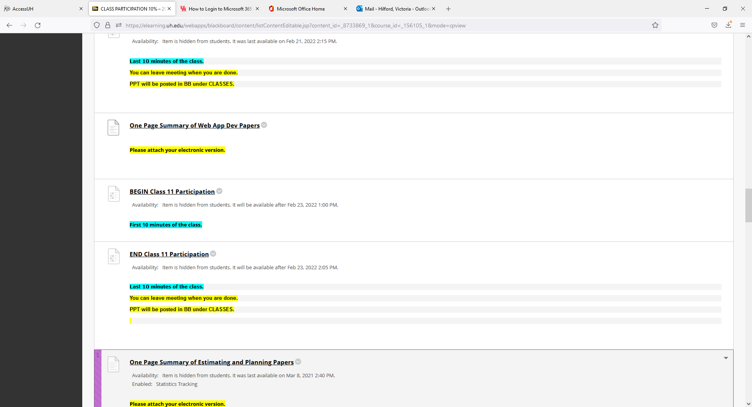
From 1:00 to 1:10 – 10 minutes.

Slide 6
Internet/Web Applications with a database back-end
From 1:10 to 1:30 – 20 minutes.
Notes:
The slides for this text are organized into chapters. This lecture covers Chapter 7.
Chapter 1: Introduction to Database Systems
Chapter 2: The Entity-Relationship Model
Chapter 3: The Relational Model
Chapter 4 (Part A): Relational Algebra
Chapter 4 (Part B): Relational Calculus
Chapter 5: SQL: Queries, Programming, Triggers
Chapter 6: Query-by-Example (QBE)
Chapter 7: Storing Data: Disks and Files
Chapter 8: File Organizations and Indexing
Chapter 9: Tree-Structured Indexing
Chapter 10: Hash-Based Indexing
Chapter 11: External Sorting
Chapter 12 (Part A): Evaluation of Relational Operators
Chapter 12 (Part B): Evaluation of Relational Operators: Other Techniques
Chapter 13: Introduction to Query Optimization
Chapter 14: A Typical Relational Optimizer
Chapter 15: Schema Refinement and Normal Forms
Chapter 16 (Part A): Physical Database Design
Chapter 16 (Part B): Database Tuning
Chapter 17: Security
Chapter 18: Transaction Management Overview
Chapter 19: Concurrency Control
Chapter 20: Crash Recovery
Chapter 21: Parallel and Distributed Databases
Chapter 22: Internet Databases
Chapter 23: Decision Support
Chapter 24: Data Mining
Chapter 25: Object-Database Systems
Chapter 26: Spatial Data Management
Chapter 27: Deductive Databases
Chapter 28: Additional Topics

Slide 7
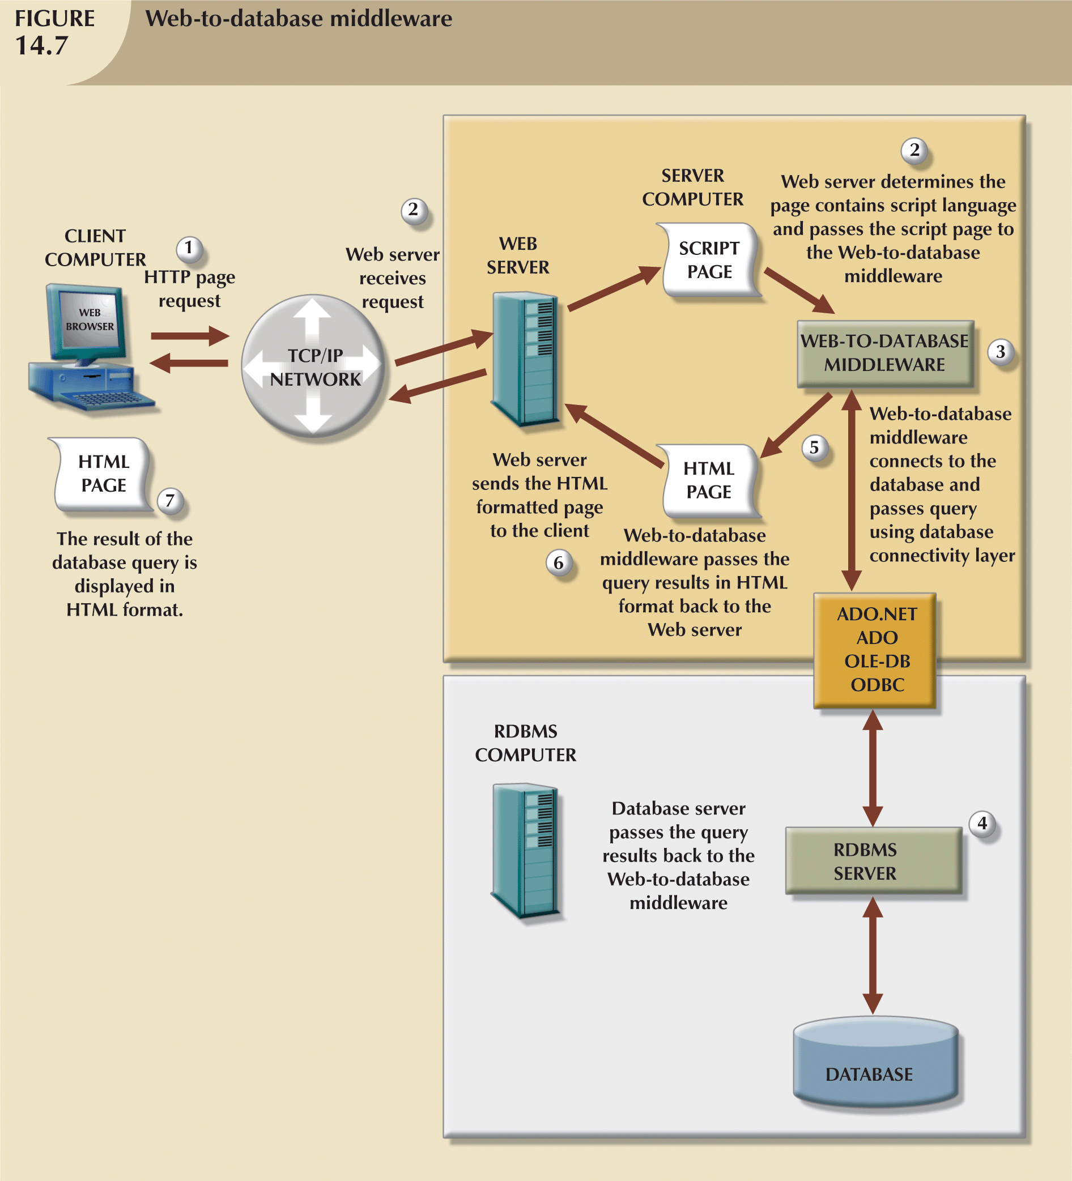
Database Application Development
Application Server
request
response
Three-tier architectures
Database Server
MS SQL SERVER DBMS
Oracle DBMS
mySQL DBMS
Notes:
15

Slide 8
3-tier Architecture (MVC)
Notes:
15

Slide 9
The Three-Tier Architecture (MVC)
Presentation tier
Client Program (Web Browser)
(V)
Application Server
Middle tier
(C)
Database Server
Data management tier
(M)

Slide 10
The Three Layers (MVC)
Presentation tier
Primary interface to the User
Needs to adapt to different display devices (PC, PDA, cell phone, voice access?)
Middle tier
Implements business logic (implements complex actions, maintains state between different steps of a workflow)
Accesses different data management systems
Data management tier
One or more standard Database Management Systems
(V)
(C)
(M)

Slide 11
Example 1: Airline Reservations
Build a system for making Airline Reservations
What is done in the different tiers?
Database System
Airline info, available Seats, Customer info, etc.
Application Server
Logic to make reservations, cancel reservations, add new airlines, etc.
Client Program
Log in different Users, display forms (Input Forms) and human-readable output (Output Reports)
(M)
(C)
(V)

Slide 12
Example 2: Course Enrollment
Build a system using which Students can enroll in courses
Database System
Student info, Course info, Instructor info, Course availability, Pre-requisites, etc.
Application Server
Logic to add a course, drop a course, create a new course, etc.
Client Program
Log in different Users (students, staff, faculty), display forms (Input Forms) and human-readable output (Output Reports)
(M)
(C)
(V)

Slide 13
3-tier Technologies (MVC)
HTML
Javascript
CSS
XSLT
Cookies
Client Program (Web Browser)
(V)
JSP Servlets
CGI
ASP.NET
PHP
Application Server (Tomcat, Apache, IIS)
(C)
Database Server (DB2)
XML
(M)
Stored Procedures

Slide 14
Advantages of the Three-Tier Architecture (MVC)
Heterogeneous systems
Tiers can be independently maintained, modified, and replaced
Thin Clients
Only presentation layer at Clients (web browsers)
Integrated data access
Several database systems can be handled transparently at the middle tier
Central management of connections
Scalability
Replication at middle tier permits scalability of business logic
Software development
Code for business logic is centralized
Interaction between tiers through well-defined APIs: Can REUSE standard components at each tier
(V)
(C)
(M)
(C)

Slide 15
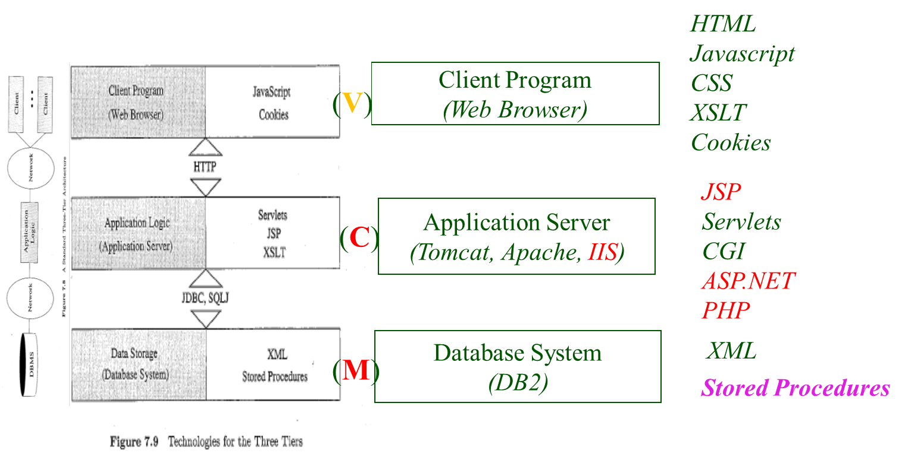
Web Database Application Development
Notes:
15

Slide 16
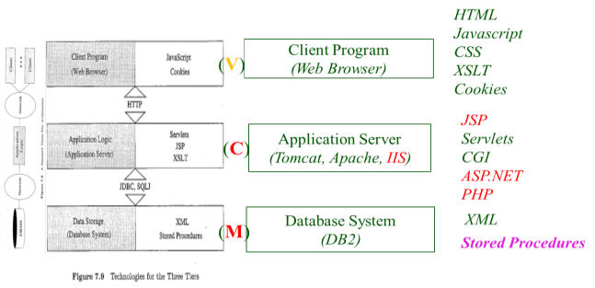

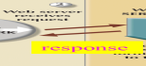
Functionality of the Middle Tier
Encodes business logic
Connects to database system(s)
Accepts Form input from the Presentation tier
Generates output for the Presentation tier
(C)
(M)
(V)

Slide 17
CGI: Common Gateway Interface
Goal: Transmit arguments from HTML Forms to Application programs running at the middle tier
Details of the actual CGI protocol unimportant → libraries implement high-level interfaces
Disadvantages:
The Application program is invoked in a new process at every invocation (remedy: FastCGI)
No resource sharing between Application programs (e.g., Database connections)
Remedy: Application Servers
action=“findbooks.cgi”
How is the HTML Form specifying the program that will receive the Form input parameters?

Slide 18
CGI: Example
HTML form (Input Form) :
<form action=“findbooks.cgi” method=POST>
Type an author name:
<input type=“text” name=“authorName”>
<input type=“submit” value=“Send it”>
<input type=“reset” value=“Clear form”>
</form>
Perl code (Output Report) :
use CGI;
$dataIn=new CGI;
$dataIn->header();
$authorName=$dataIn->param(‘authorName’);
print(“<HTML><TITLE>Argument passing test</TITLE>”);
print(“The author name is “ + $authorName);
print(“</HTML>”);
exit;
request
response
Output Report is in HTML

Slide 19
Application Server: Process Structure
(C)
Main pool of threads of processes
Manage connections
Enable access to heterogeneous data sources
Other functionality such as APIs for session management
(M)
(V)
Web Browser
Web Server
HTTP
C++ Application
(C)
JavaBeans
Application Server
JDBC
DBMS 1
ODBC
DBMS 2
(M)
Pool of Servlets

Slide 20
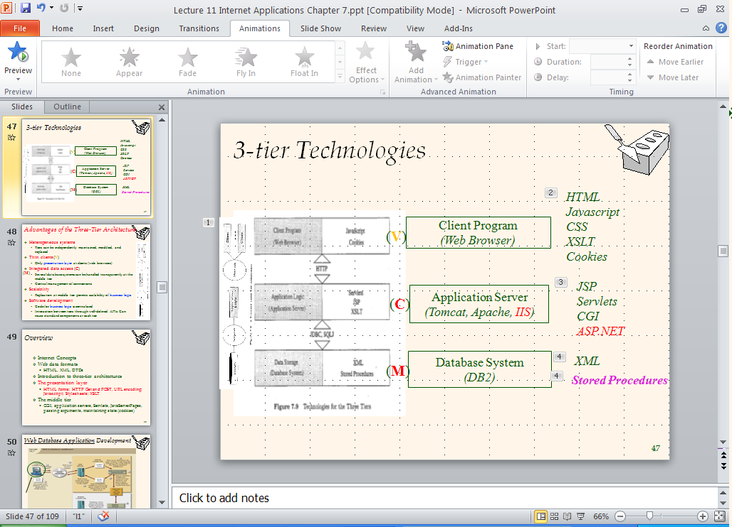
Servlets
(C)
Java Servlets: Java code that runs on the middle tier
Platform independent
Complete Java API available, including JDBC
Example:
import java.io.*;
import java.servlet.*;
import java.servlet.http.*;
public class ServetTemplate extends HttpServlet
{
public void doGet(HTTPServletRequest request, HTTPServletResponse response) throws SerletExpection, IOException
{ PrintWriter out=response.getWriter();
out.println(“Hello World”);
}
}
JAVA first!

Slide 21
Servlets
Life of a servlet?
Web Server forwards request to servlet container
Container creates servlet instance (calls init() method; deallocation time: calls destroy() method)
Container calls service() method
service() calls doGet() for HTTP GET or doPost() for HTTP POST

Slide 22
Servlets: A Complete Example
public class ReadUserName extends HttpServlet
{
public void doGet(HttpServletRequest request, HttpSevletResponse response)
throws ServletException, IOException
{
response.setContentType(“text/html”);
PrintWriter out=response.getWriter();
out.println(“<HTML><BODY>\n <UL> \n” +
“<LI>” + request.getParameter(“userid”) + “\n” +
“<LI>” + request.getParameter(“password”) + “\n” +
“<UL>\n<BODY></HTML>”);
}
public void doPost(HttpServletRequest request, HttpSevletResponse response)
throws ServletException, IOException
{
doGet(request,response);
}
}
Produces HTML!
Output Report is in HTML

Slide 23
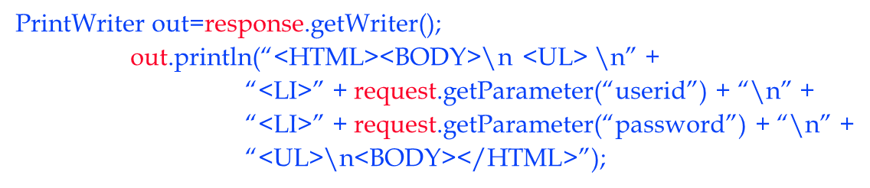
Servlets vs. Java Server Pages (JSP)
Servlets
Generate HTML by writing it to the “PrintWriter” object out
Code first, Webpage second (HTML)
Java Server Pages (JSP)
Written in HTML, Servlet-like code embedded in the HTML
Webpage first (HTML), Code second
They are usually compiled into a Servlet
JAVA first!
HTML first!

Slide 24
Java Server Pages (JSP)
Java Server Pages
Written in HTML, JAVA Code embedded in the HTML
Webpage first, Code second
HTML first!

Slide 25
Java Server Pages: Example
request
<html>
<head><title>Welcome to B&N</title></head>
<body>
<h1>Welcome back!</h1>
<% String name=“NewUser”;
if (request.getParameter(“username”) != null)
{ name=request.getParameter(“username”);
}
%>
You are logged on as user <%=name%>
</body>
</html>
JAVA
JAVA

Slide 26
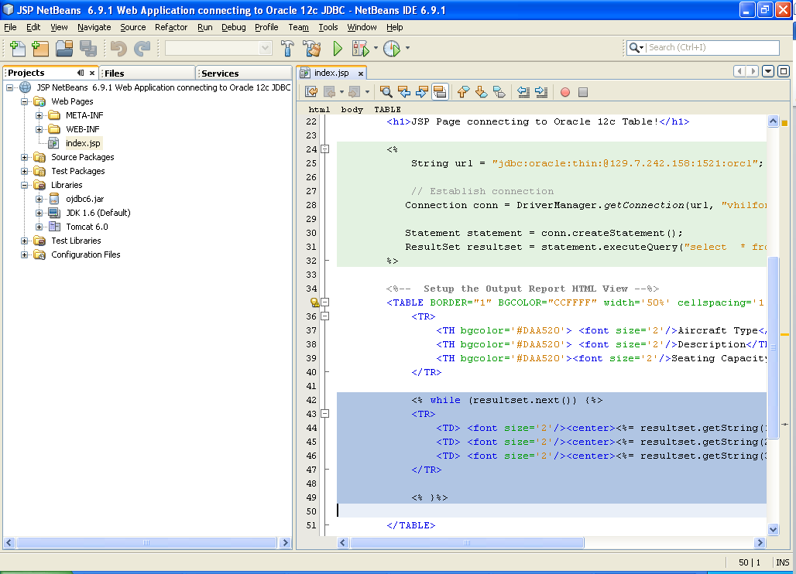
JSP to oracle 12c DBMS: A Complete Example
JAVA
129.7.242.225
JDBC
JAVA

Slide 27
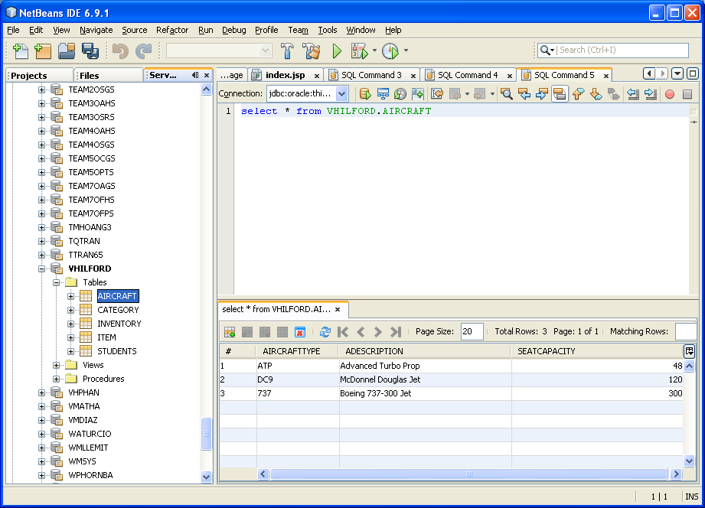
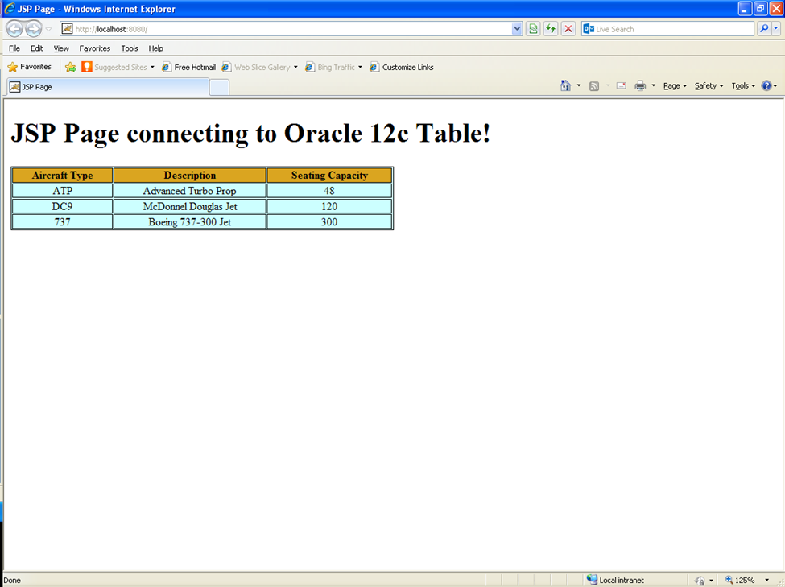
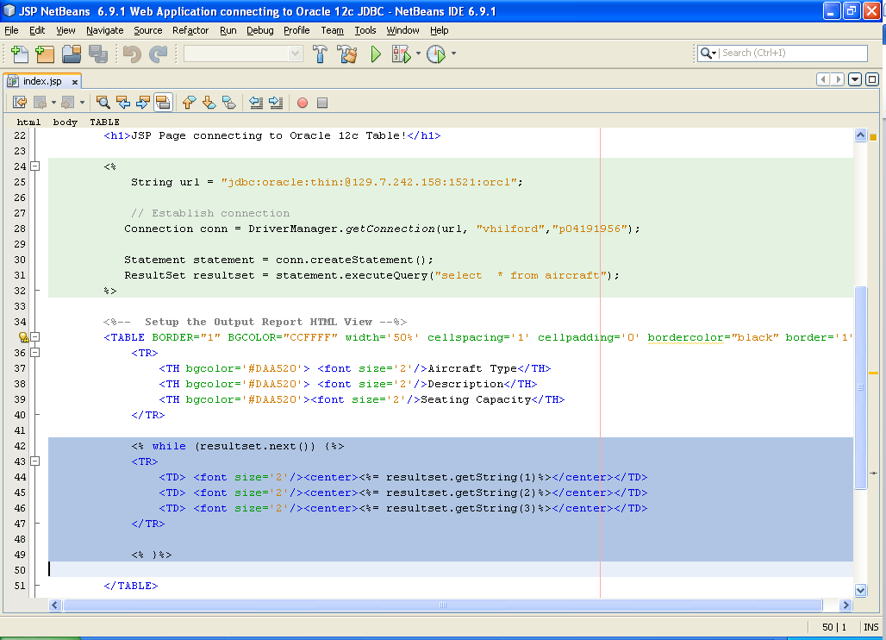
JSP to oracle 12c DBMS: A Complete Example
DATABASE
WEB PAGE

Slide 28
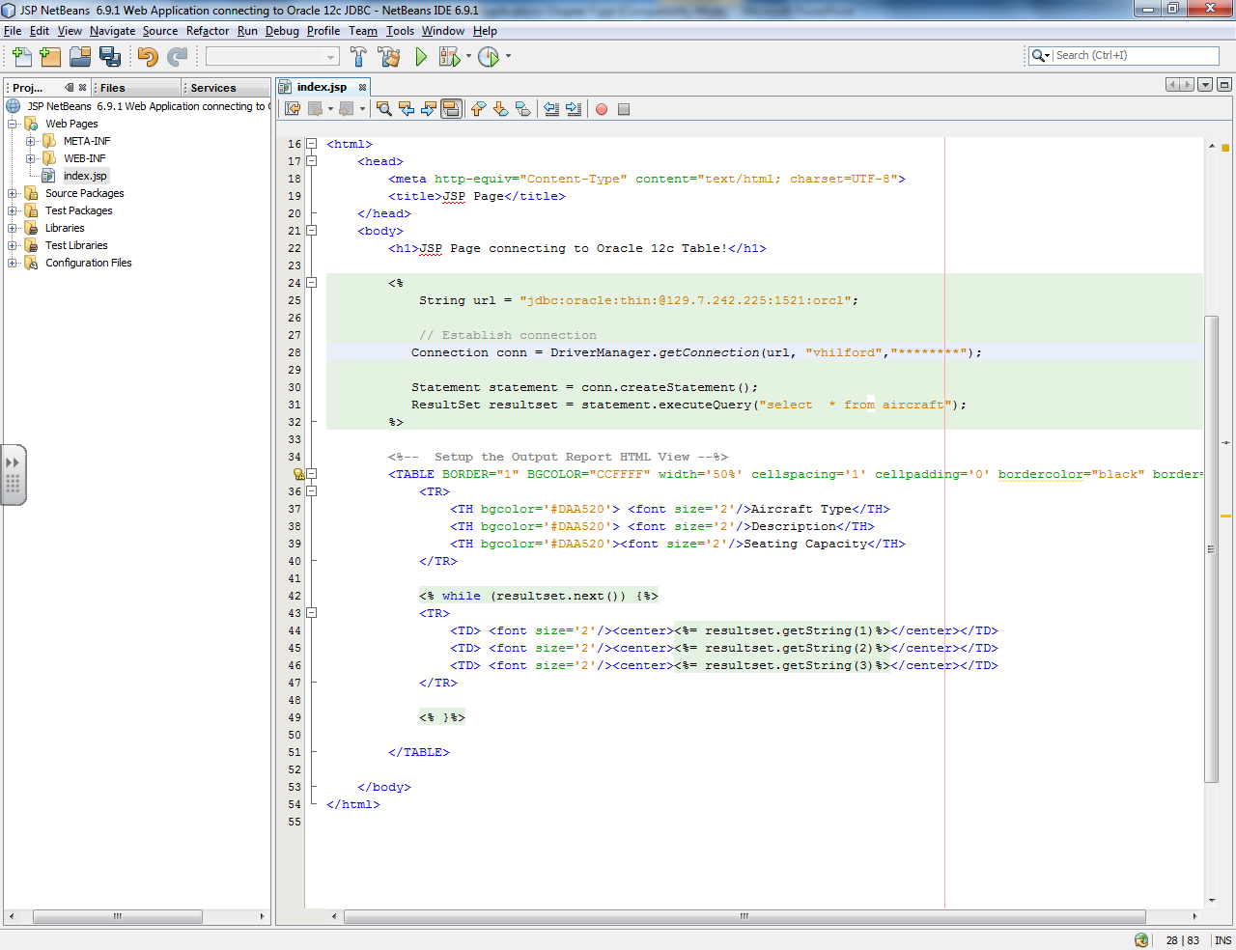
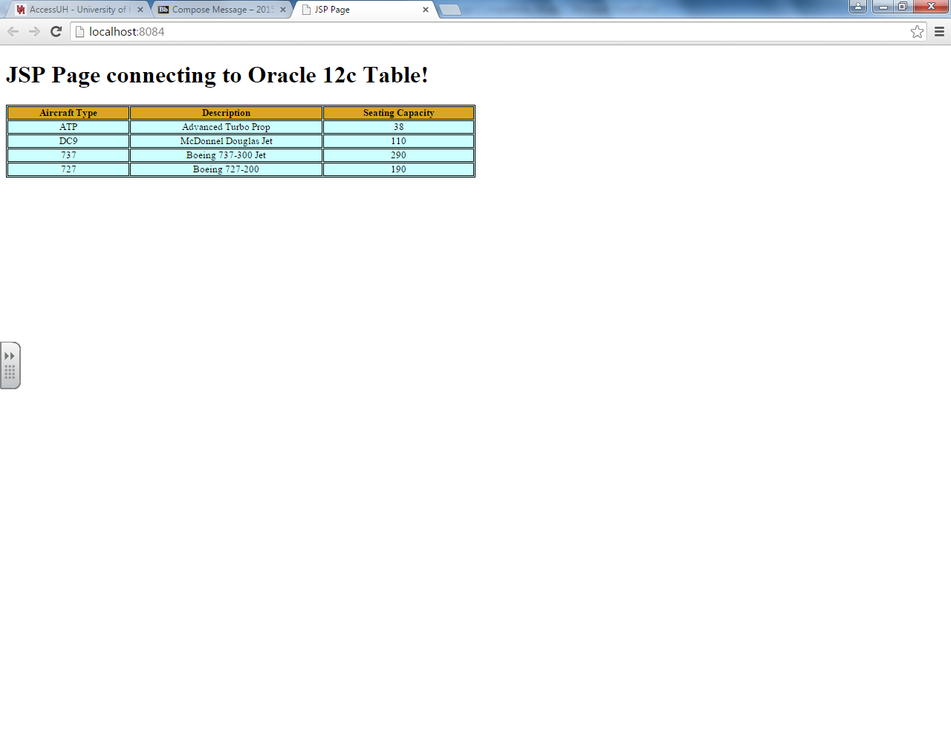
NetBeans IDE has Apache Tomcat built in to serve this web page

Slide 29
Active Server Pages (ASP)
http://msdn.microsoft.com/en-us/library/ms972337.aspx
Active Server Pages
A series of objects and components that are executed on the web server IIS
Uses a suite of technologies that allows dynamically-generated content
Control of how content is generated from the Server to the Browsers

Slide 30
ASP Page Execution
You Request an ASP Page www.ocstc.org/default.aspx
Server finds the page
Server executes ASP commands, converts ASP to HTML/XML as needed, processes HTML/XML
Browser displays the page

Slide 31
ASP Compared to Other Languages
ASP and /PHP/Perl/CGI/JSP execution are roughly equivalent in execution sequence
Compared to JavaScript, don’t have to worry about Browser versions or disabling
Compared to Java, don’t have to worry about whether JRE (or MVM) is installed

Slide 32
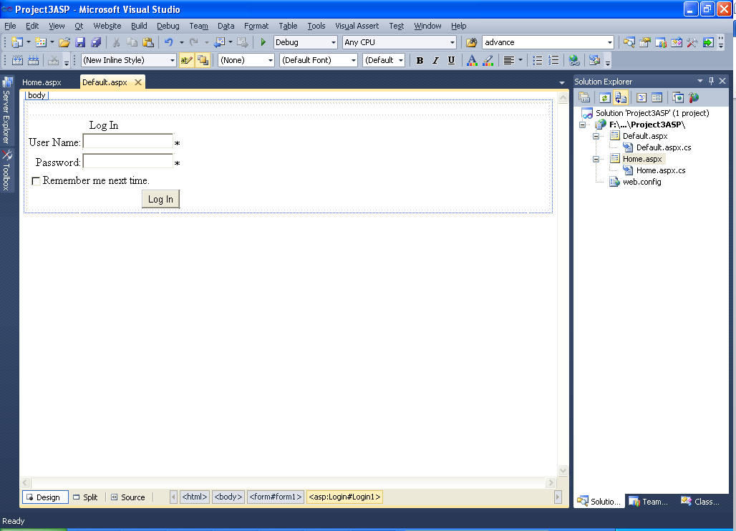
ASP to MS SQL DBMS Server : A Complete Example
Visual Studio IDE has IIS built in to serve this web page

Slide 33
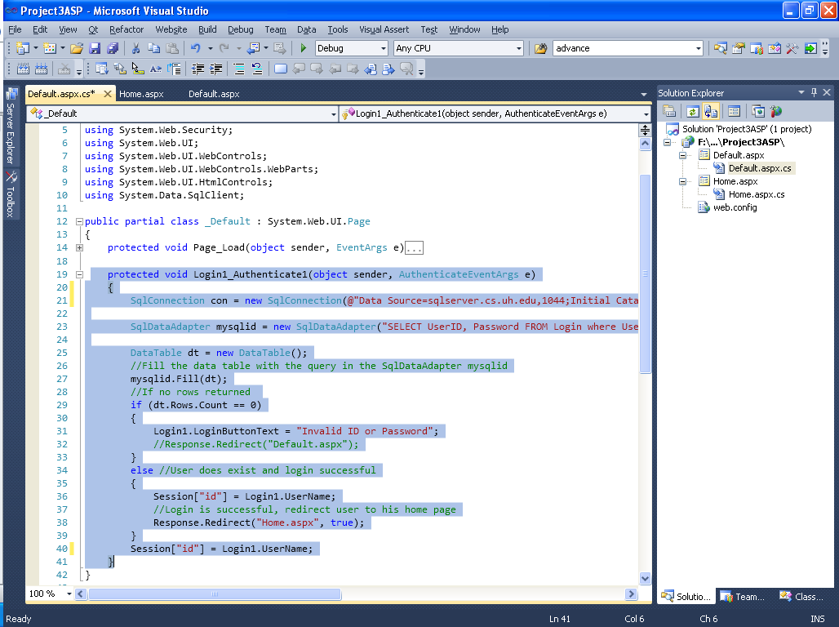
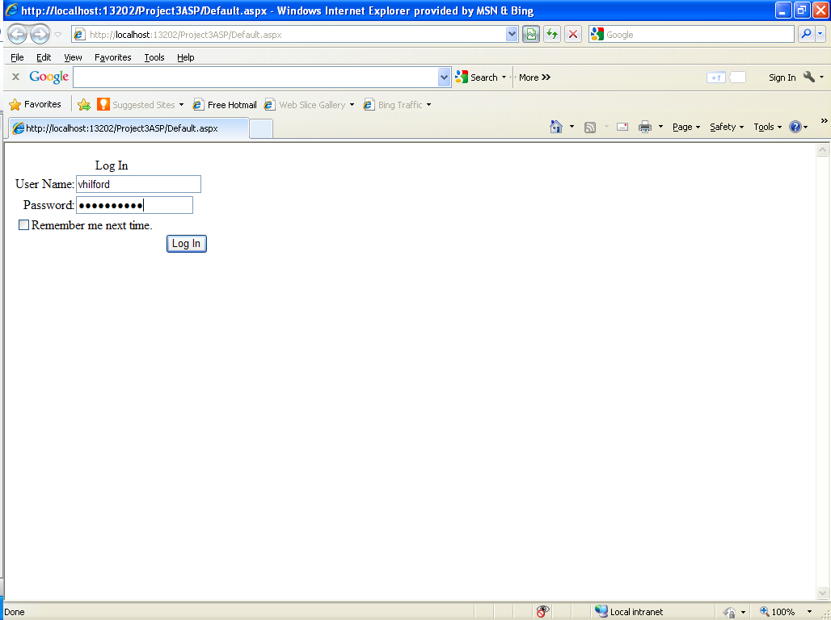
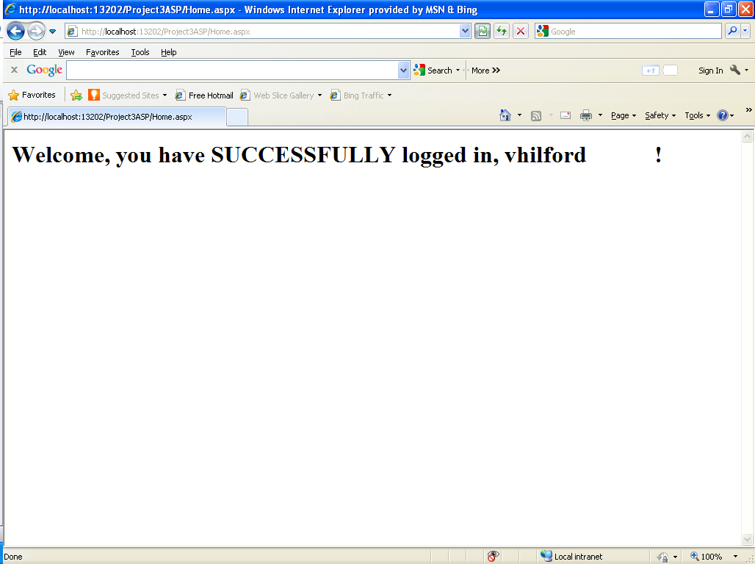
ASP to MS SQL DBMS Server : A Complete Example

Slide 34
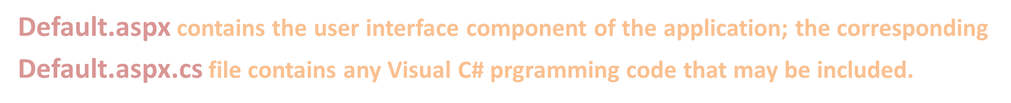
ASP to MS SQL DBMS Server : A Complete Example

Slide 35
ASP to MS SQL DBMS Server : A Complete Example
A SqlDataSource server control is used to associate ASP webforms with either SQL Server or Oracle database.

Slide 36
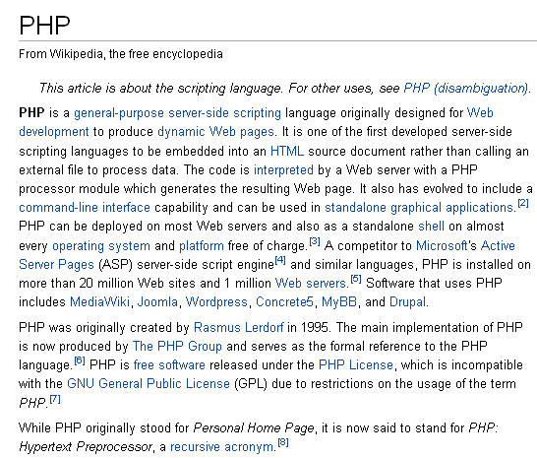

Slide 37
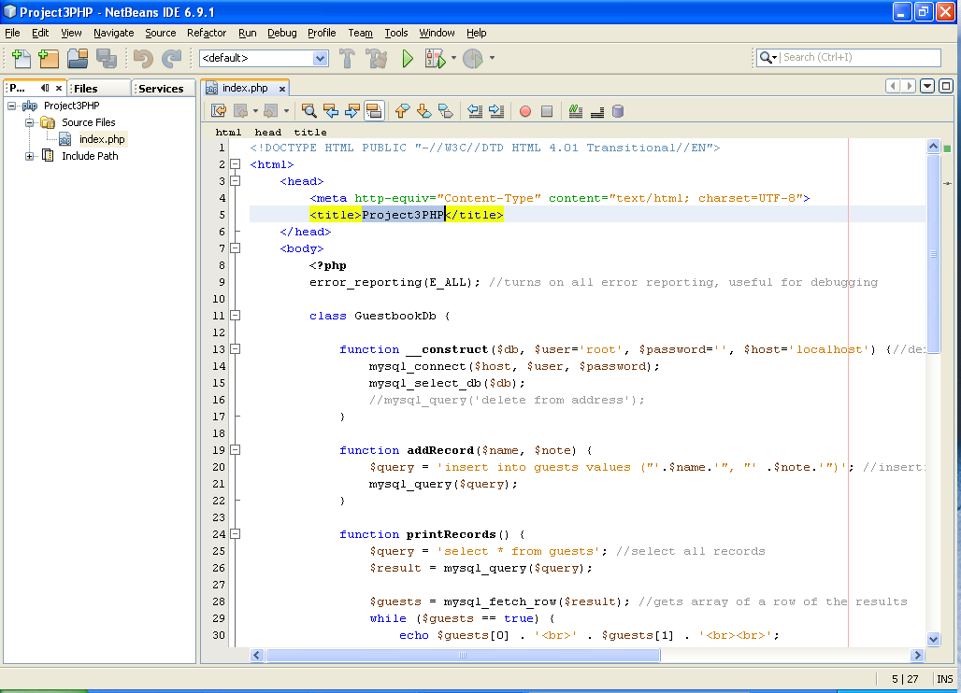
PHP to mySQL Server DBMS : A Complete Example
PHP

Slide 38
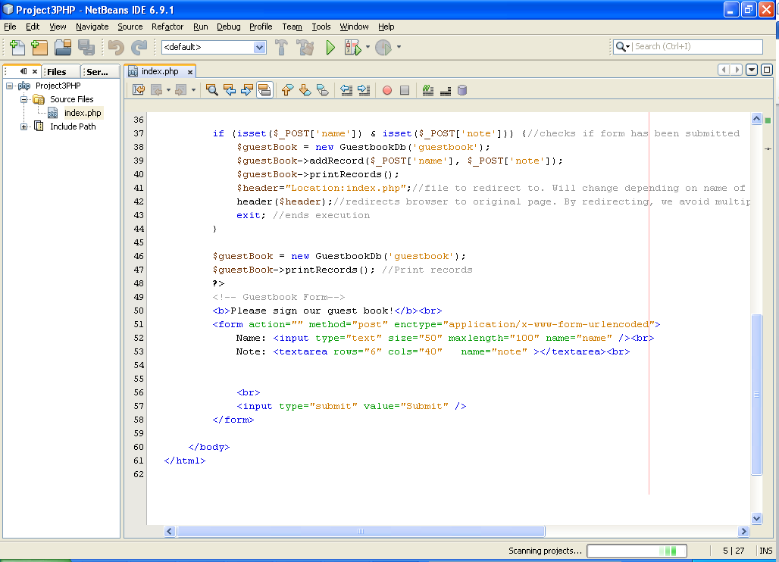
PHP to mySQL DBMS Server : A Complete Example
action=‘index.php’
HTML Form

Slide 39
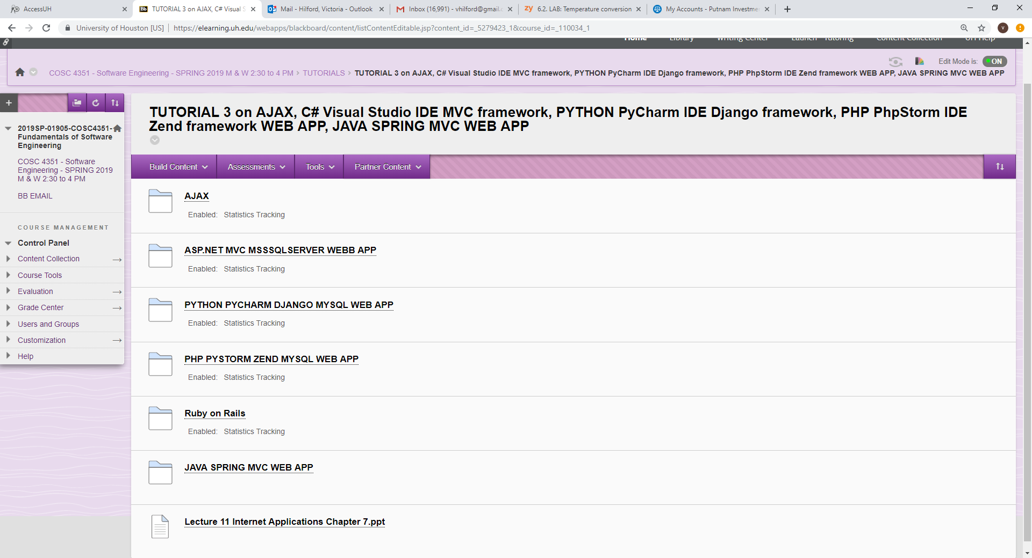
From 1:30 to 2:00 – 30 minutes.

Slide 40
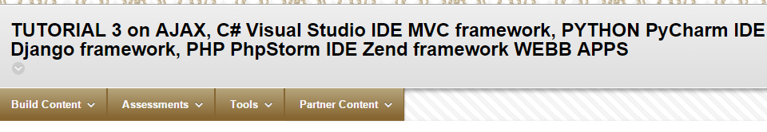
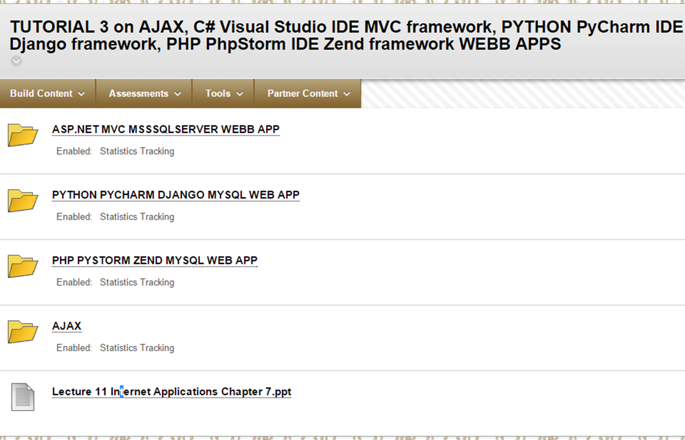
From 1:30 to 1:36 – 6 minutes.

Slide 41
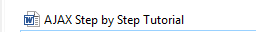
AJAX NetBeans JSP pages
AJAX Visual Studio ASP pages

Slide 42
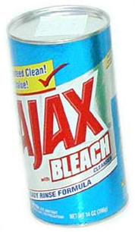
AJAX Asynchronous JAvaScript & XML
AJAX?

Slide 43
Web Database Application Development
Notes:
15

Slide 44
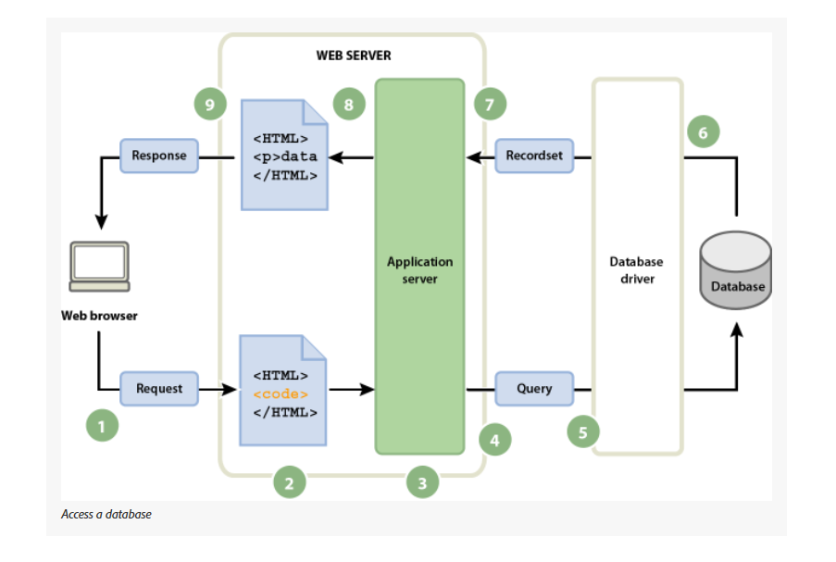
Web Database Application Development
Notes:
15

Slide 45
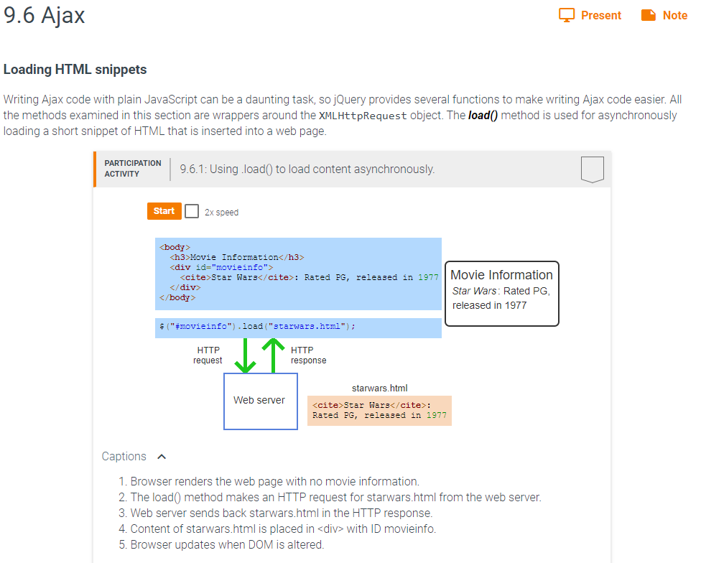

Slide 46
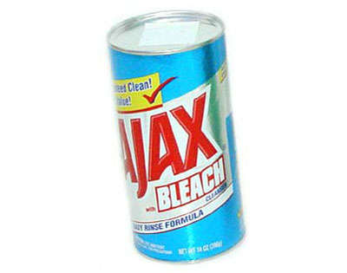
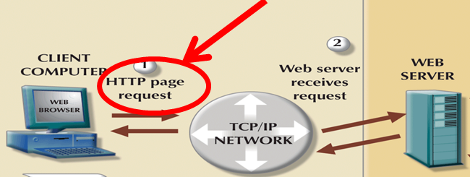
AJAX Overview
A group of interrelated Web development methods used on the Client-side to create interactive Web Applications.
Allows Web Applications to retrieve Data from the server asynchronously in the background without interfering with the display and behavior of the existing page. Data is usually retrieved using the XMLHttpRequest object.
Despite the name, the use of XML is not needed, and the requests need not be Asynchronous.

Slide 47
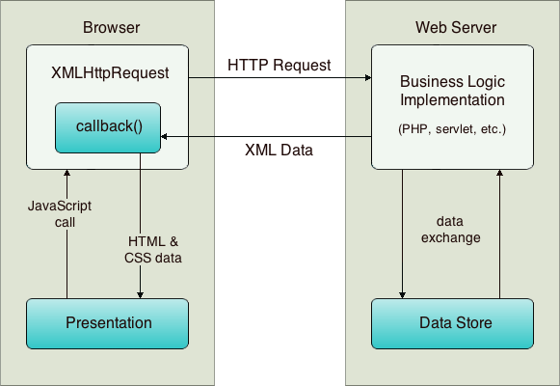

Controller
View
Model

Slide 48




AJAX IDE’s
Visual Studio C# ASP
Netbeans JAVA JSP
Aptana
Zend PHP
Notes:
MRT

Slide 49
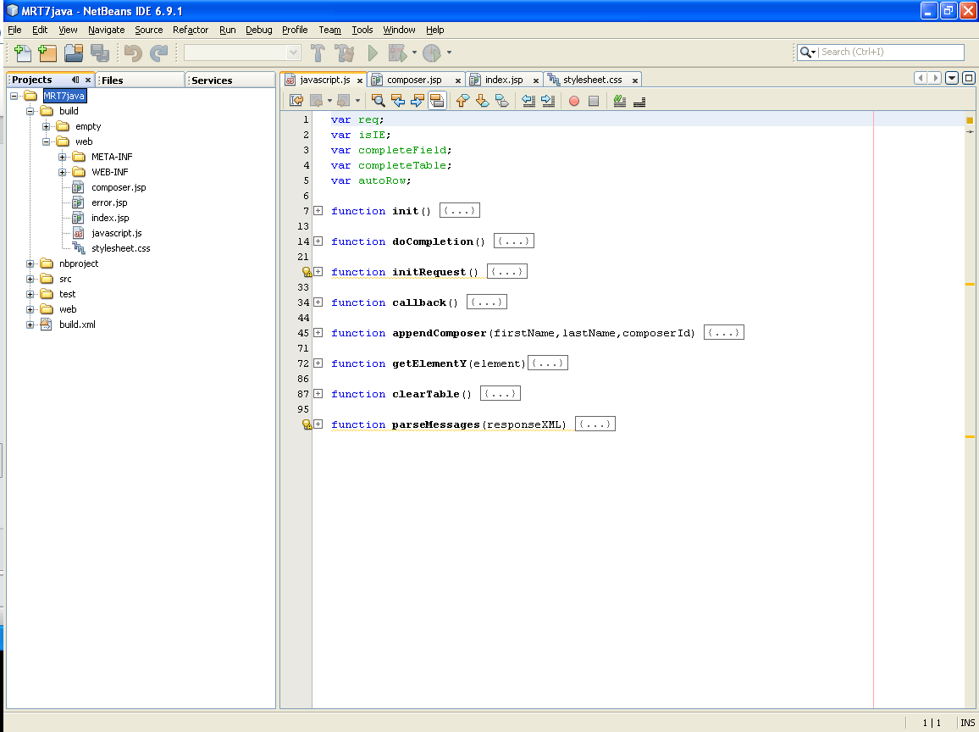
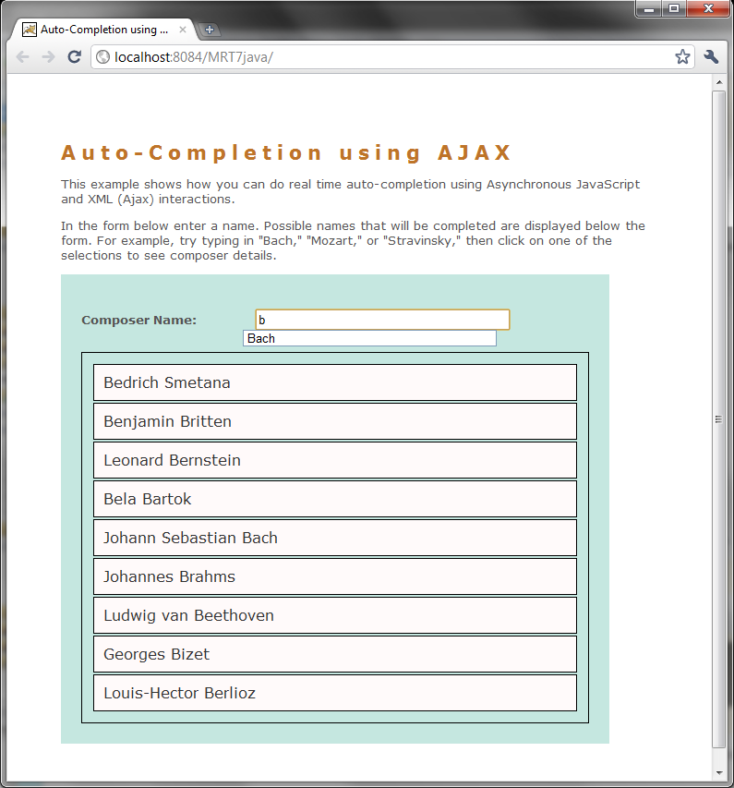
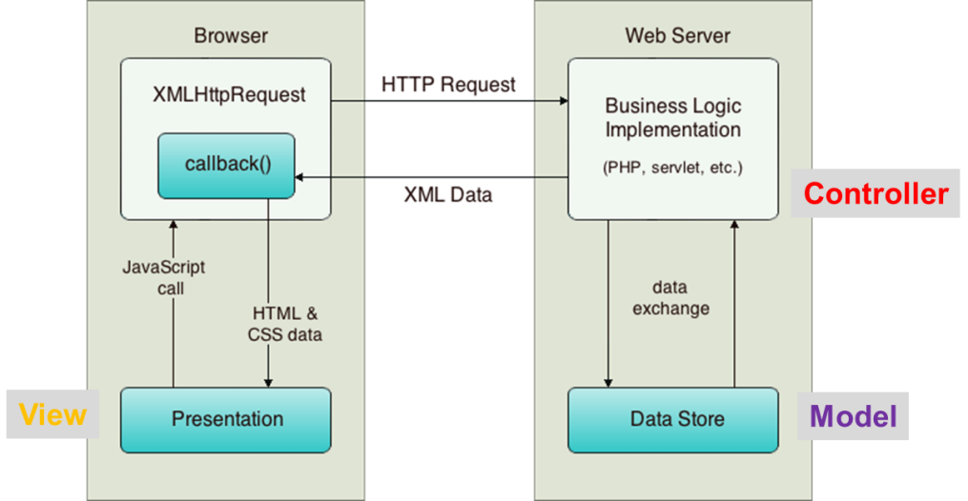
AJAX NetBeans JSP pages

Slide 50
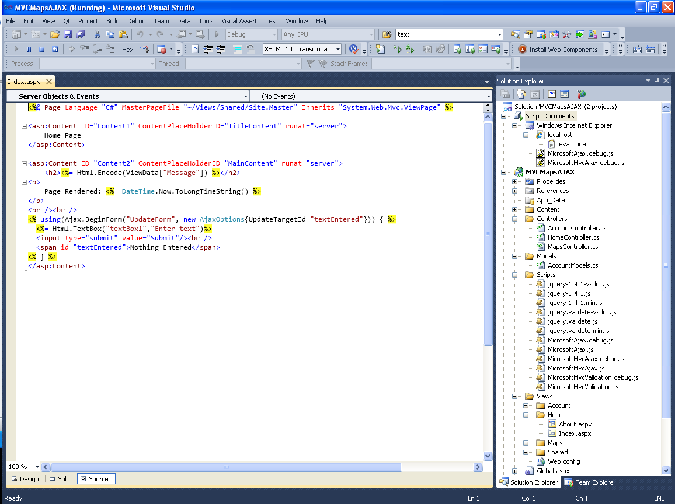
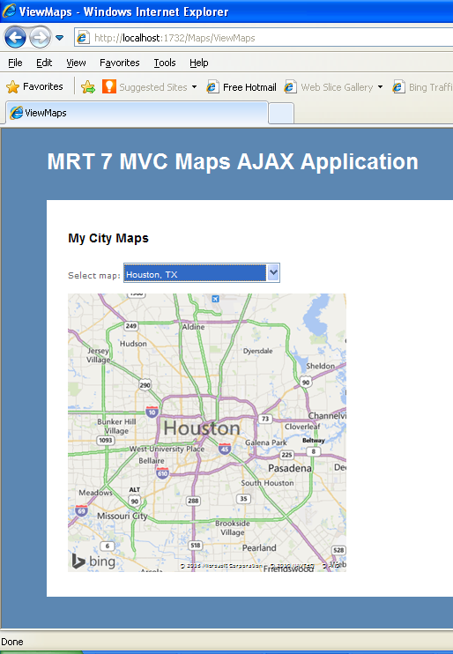

AJAX Visual Studio ASP pages
C
M
V

Slide 51
From 1:36 to 1:42 – 6 minutes.

Slide 52
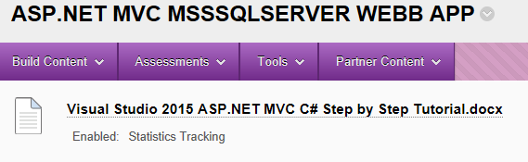

Slide 53
What's ASP.NET MVC
Microsoft framework that builds on top standard ASP.NET engine
ASP.NET Web Form
ASP.NET MVC
Core standard ASP.NET engine
Microsoft .NET Framework

Slide 54
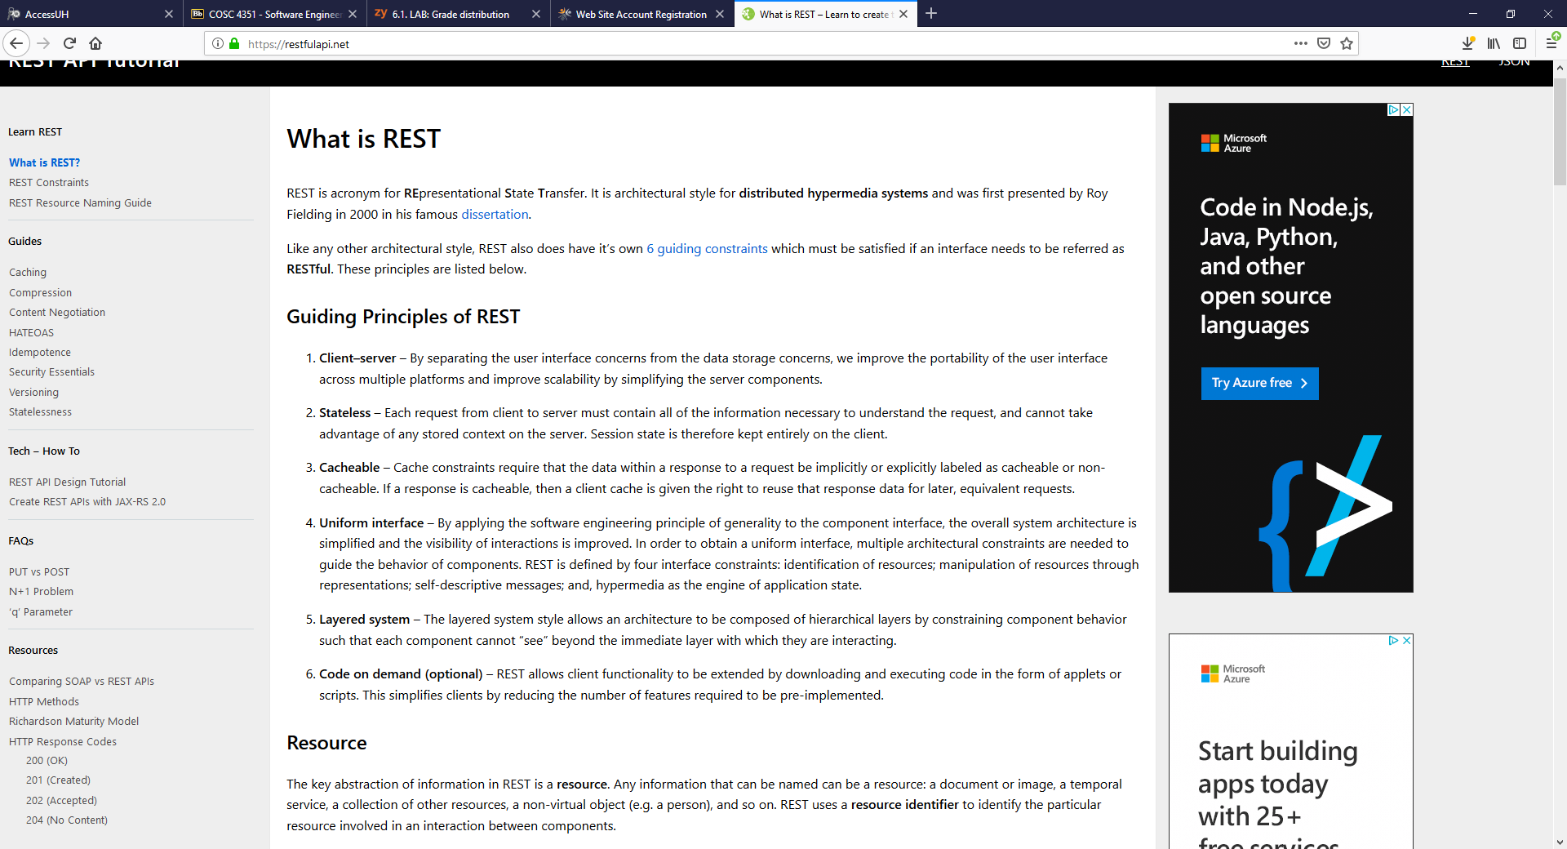
Goals of ASP.NET MVC
Testability
Pluggable
REST API for JSON data exchange*
Existing ASP.NET feature still available
Full control of HTML (HTML5)
Open source
* JSON is an acronym for JavaScript Object Notation.
Notes:
Testability
- Framework provides interface-base → easy to mackable
Pluggable
- Every component can easy replaced or customize (view replaced with ironPython)
- Easy to use dependency injection design pattern (unity, spring)
Friendly URL
- Can build app for search engine friendly
Existing ASP,NET feature still available
- All exist asp.net feature still available ex: Master.Page, User Control, Session, Memberdhip
- But ViewState and page life cycle are not support
Full control of HTML
- Write only html
- no viewstate
Open source
- under MS-PL license

Slide 55
How does it work?
Controller is responsible for handling incoming request
Routing system decides how URLs map into particular controllers and actions
http://localhost:1725/Hello/ActionTest
Controller
Action in controller
Notes:
Controller is responsible for handling incoming request
- All public method that implement by Controller class, It can be invoke from web via url.

Slide 56
Routing
Component is first hit by a request
The rules are configured in Global.asax.cs
public static void RegisterRoutes(RouteCollection routes)
{
routes.MapRoute(
"Default",
"{controller}/{action}/{id}",
new { controller = "Home", action = "Index", id = "" }
);
}
http://localhost:1725/Product/Show/1
Notes:
Controller is responsible for handling incoming request
- All public method that implement by Controller class, It can be invoke from web via url.

Slide 57
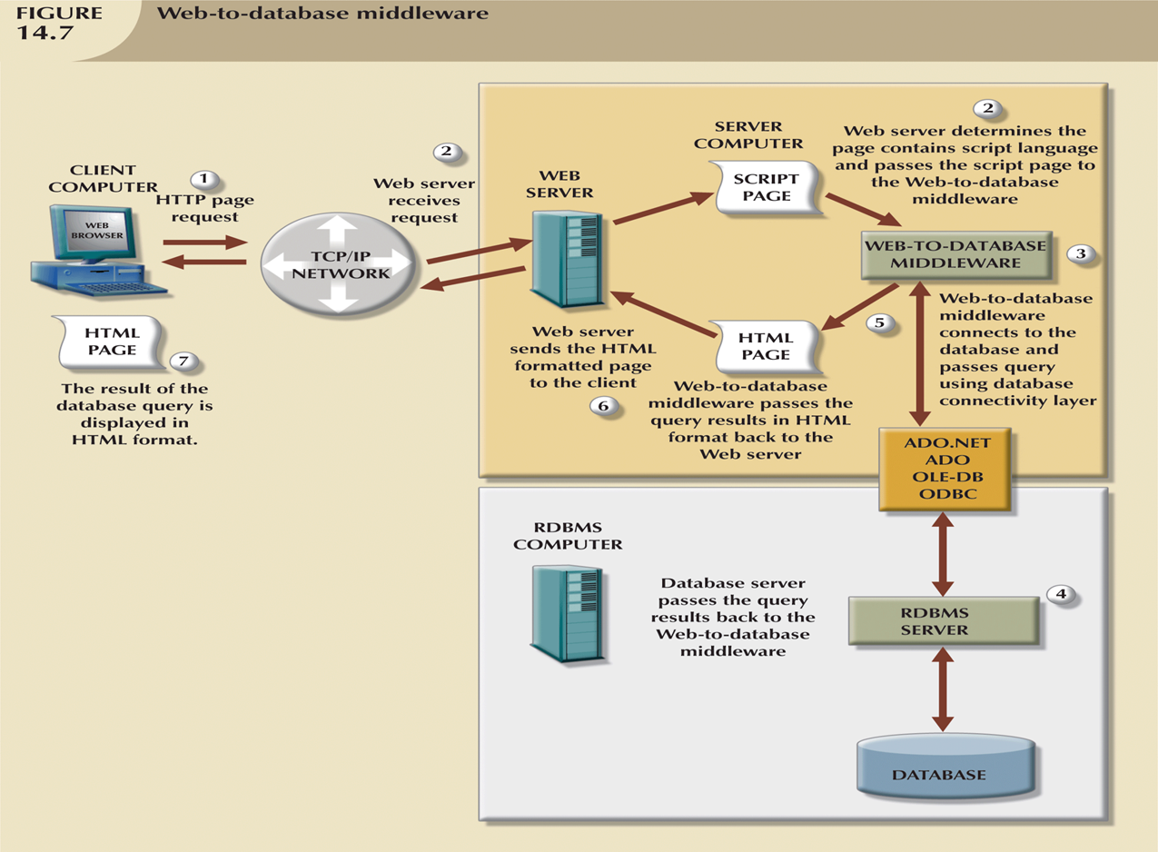

Slide 58
Request Flow
Request
Routing
View
Controller
Model
Input
Form
(HTML)
HTTP
Select Controller
Output
Report
(HTML)
Select
View
HTML

Slide 59
Summary
ASP.NET WebForms | ASP.NET MVC
Combines Code and View | Separation of Concerns
Cannot test easily | Design for testing
Event-driven programming (Drag n’ drop) | Full control over HTML Clean HTML
Complex URL | RESTful URL
Notes:
Uses the ‘Page Controller’ pattern. Each page has a code-behind class that acts as a controller and is responsible for rendering the layout.
Uses the ‘Front Controller’ pattern. There is a single central controller for all pages to process web application requests and facilitates a rich routing architecture

Slide 60
From 1:42 to 1:48 – 6 minutes.

Slide 61
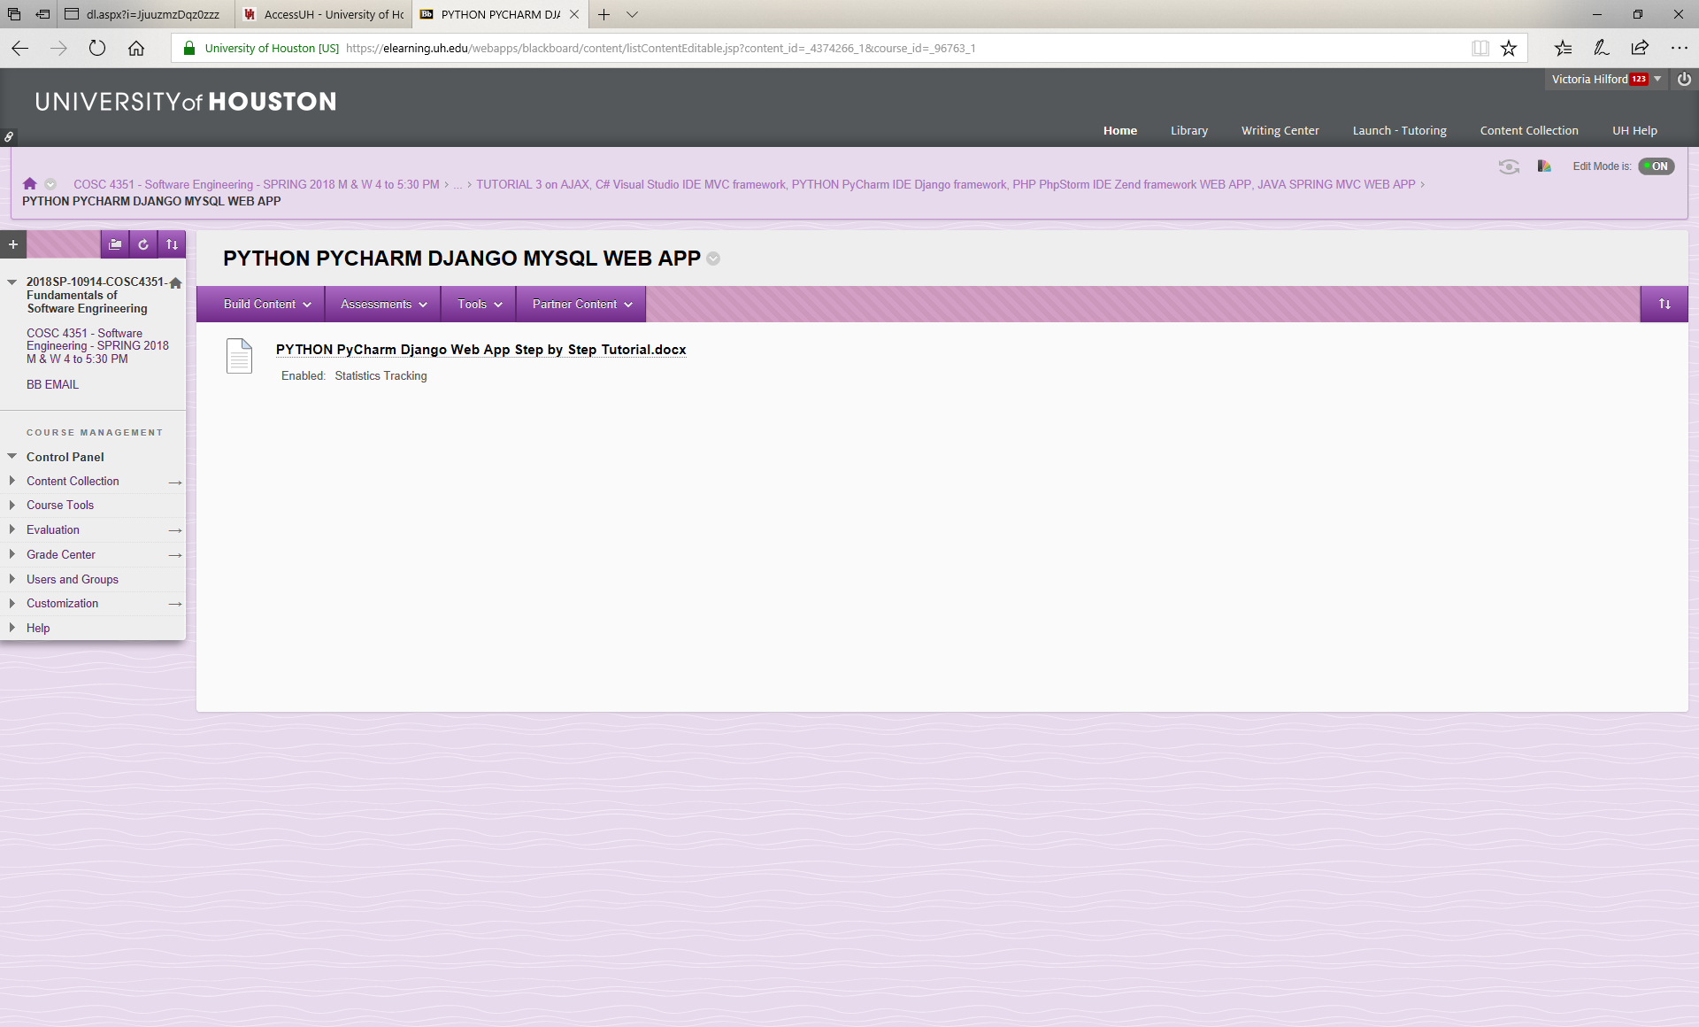
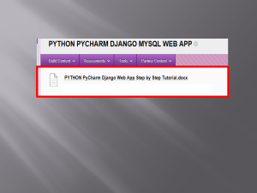

Slide 62
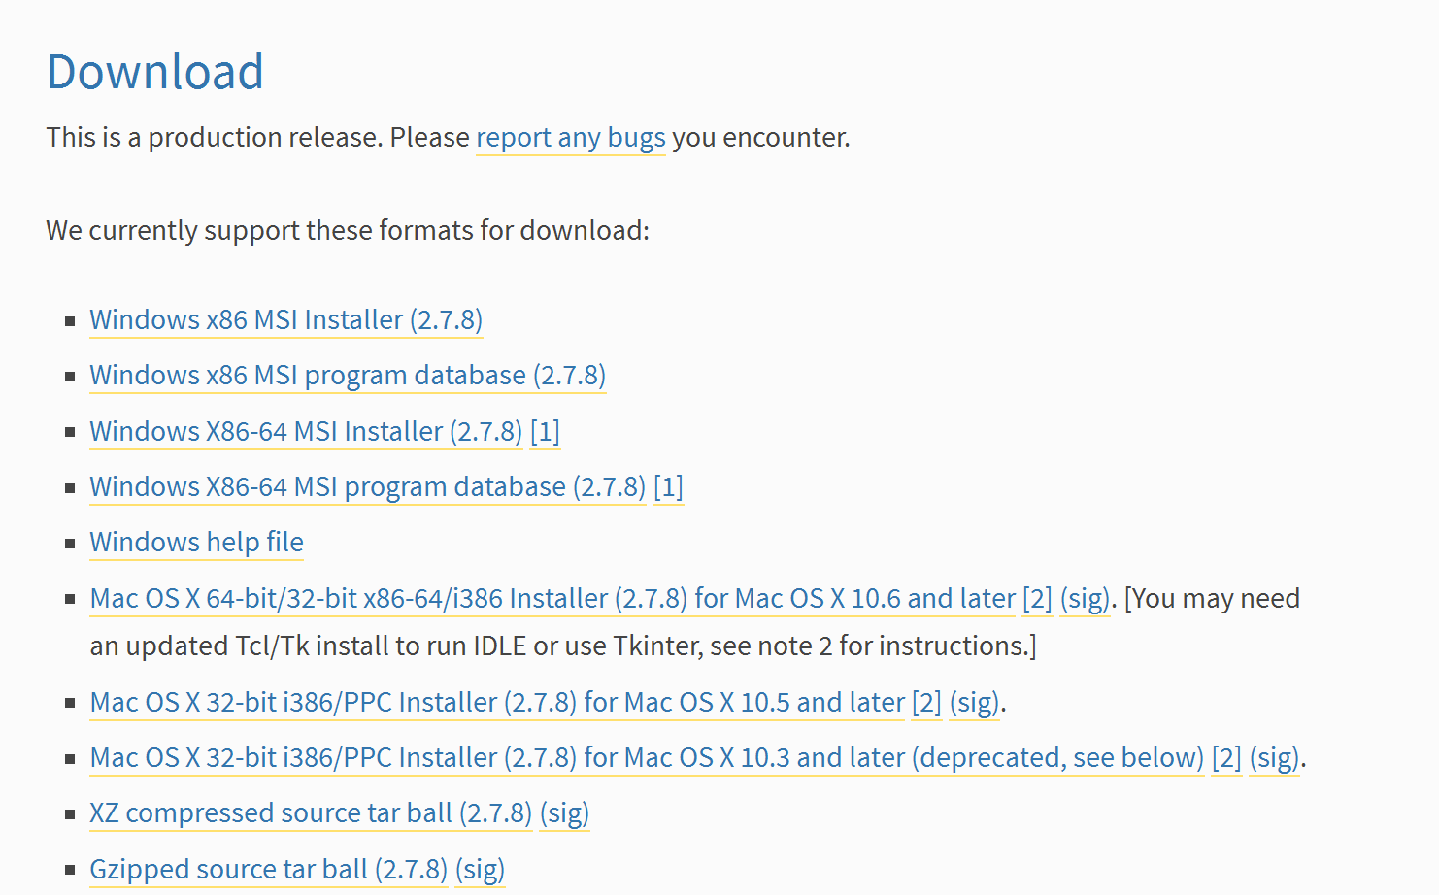
Download the Python Interpreter
In your browser go to https://www.python.org/download/releases/2.7.8/
Scroll Down to the Download Section
Choose the version of python that matches your OS
For windows choose the MSI installer and not the program database

Slide 63
Install Python Interpreter
Click next on all prompts until the software is installed

Slide 64
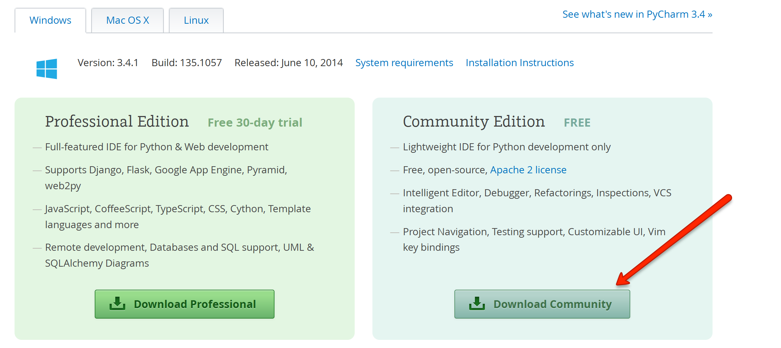
Download PyCharm IDE Community Edition
In your browser go to http://www.jetbrains.com/pycharm/download/
Click the Download Community button on the right

Slide 65

Install PyCharm IDE Community Edition
Click Next on all prompts until you get to the following screen
Click the checkbox next to Run Pycharm Community Edition and then Click Finish

Slide 66

Install PyCharm IDE Community Edition
Make sure the “I do not have a previous version of PyCharm or I do not want to import my settings” is selected and click the OK button

Slide 67

Install PyCharm IDE Community Edition
Click the OK button
As easy as installing NetBeans, Eclipse, etc. IDEs

Slide 68

Create a new Project

Slide 69

Create a new Project
In the Project Name textbox type a project name, in this screenshot the project name is INLS 560 and click the OK button

Slide 70

PyCharm IDE with Django MVC Framework
M
V
TDD

Slide 71
From 1:48 to 1:54 – 6 minutes.

Slide 72



Slide 73

PHP Zend Framework Tutorial

Slide 74


PHP Zend Framework Tutorial
NetBeans PHP Zend Framework Project

Slide 75


PHP Zend Framework Tutorial
NetBeans PHP Zend Framework Project Wamp

Slide 76


PHP Zend Framework Tutorial
NetBeans PHP Zend Framework Project Wamp
C
M
V

Slide 77
ZF Zend Framework
ZF’s flexible Model-View-Controller (MVC) implementation
Keeps your code organized logically and handles “plumbing”
Components (Libraries)
Including Classes to access web services

Slide 78
What is ZF?
An open source, MVC - based PHP Framework
Is it a Framework? Yes
"Glue" to build applications
Components developed, tested, distributed together
But loosely coupled
“Use at will” architecture

Slide 79
Birth and early years
2005: PHP Collaboration Project at ZendCon
Started as collection of components but coalesced
PHP 5, Object Oriented (OO) from the start
Set example of OO Design Patterns and Practices

Slide 80
Model – View – Controller Design Pattern
Model
Classes that access your data
View
Templates to present that data (e.g. HTML for browser)
Controller (action controller)
Application flow
Connects Model and View
(Bonus: front Controller!)

Slide 81
Front Controller Design Pattern
Front Controller sits in front of MVC
All PHP requests funneled through index.php (bootstrap file)
Front Controller gets your application started
Initializes request/response objects
Can handle common settings and functionality
“Include” paths
Configurations
Location of MVC components (if necessary)
Logging, db (perhaps), authentication/authorization
Converts URL to a “request” object with distinct parts
Routes requests to appropriate action Controllers
Receives exceptions

Slide 82

Front Controller to action Controller

Slide 83
Routes URL request
Default routing convention:
http://example.com/controller/action/param1/value1...
Controller maps to class name
Param/value pairs are passed to action
Action maps to method name
http request
Controller1 action1() action2()
Bootstrap: index.php
Front Controller
Controller2 action1() action2()

Slide 84

Controller example
C
M
V

Slide 85
View
Scripts (templates)
PHP-based script templates to present data
Should contain only display logic, not business logic
Default naming: “myaction.phtml”
Helpers
Classes and methods that provide reusable View functionality
Examples of built-in view helpers: escape(), formText(), partial(), partialLoop(), headTitle()
Write your own, too
Output filters
Layout
Placeholders

Slide 86
Controller (again)…leads to View
C

Slide 87



View script automatically rendered
V

Slide 88

Zend_Layout
/ Master Page

Slide 89

Tools can help get you started
Zend Studio for Eclipse creates default directory structures and Classes for you
Free trial: http://www.zend.com/en/products/studio/
Zend Framework for NetBeans 6.9.1

Slide 90

Tools can help get you started
Zend Framework for NetBeans 6.9.1 creates default directory structures and Classes for you

Slide 91

From 1:54 to 2:00 – 6 minutes.
Ruby on Rails

Slide 92


Ruby
on Rails

Slide 93
Rails
extremely productive MVC framework for database-backed Web apps
DRY – Don’t Repeat Yourself!
CoC – Convention over Configuration
Manage database through SQLite and migrations

Slide 94




Who uses Ruby on Rails?

Slide 95


C

Slide 96


V

Slide 97


M

Slide 98
At 2:00.
HAD ENOUGH? TAKE ONE (YOUR CHOICE) AND PRACTICE

Slide 99




Due 04.20.2022

Slide 100


Slide 101



Slide 102
From 2:05 to 2:15 – 10 minutes.
VH Download Meeting Participants

Slide 103
At 2:15.
End Class 11
VH, upload Class 11 to BlackBoard.

